Slide 1

Chapter 3 Simple Sorting
CSC220 Data Structure
Winter 2004-5
Faculty of Computer Science, University of Computer Studies(UCSY)

Slide 2
Outline
Introduction
Bubble Sort
Selection Sort
Insertion Sort
Comparison
Faculty of Computer Science, University of Computer Studies(UCSY)

Slide 3


Sorting
Figure 1
Figure 2
Faculty of Computer Science, University of Computer Studies(UCSY)

Slide 4
Introduction
Why do we need to sort data ?:
-- to arrange names in alphabetical order
-- arrange students by grade, etc.
-- preliminary step to searching data.
Basic steps involved:
-- compare two items
-- swap the two items or copy one item.
Faculty of Computer Science, University of Computer Studies(UCSY)

Slide 5
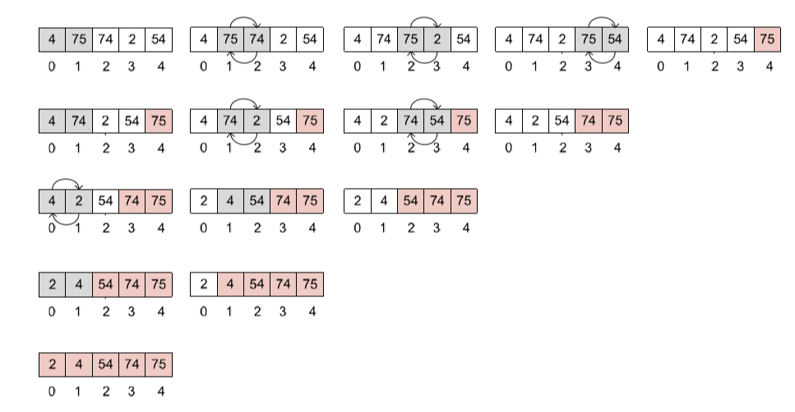
Bubble Sort (Exchange Sort)
Compare two items
If one on the left is greater, swap them else move right.
Move one position right.
Faculty of Computer Science, University of Computer Studies(UCSY)

Slide 6
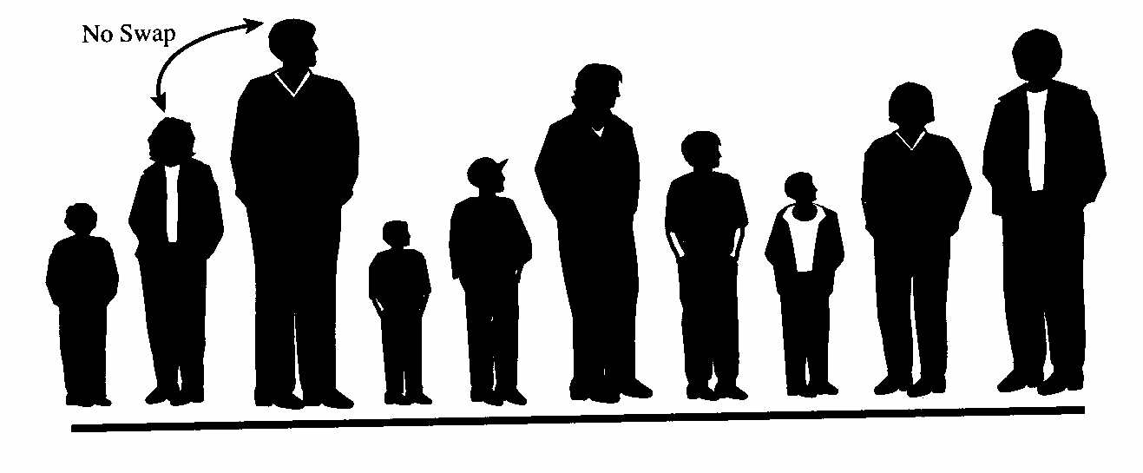

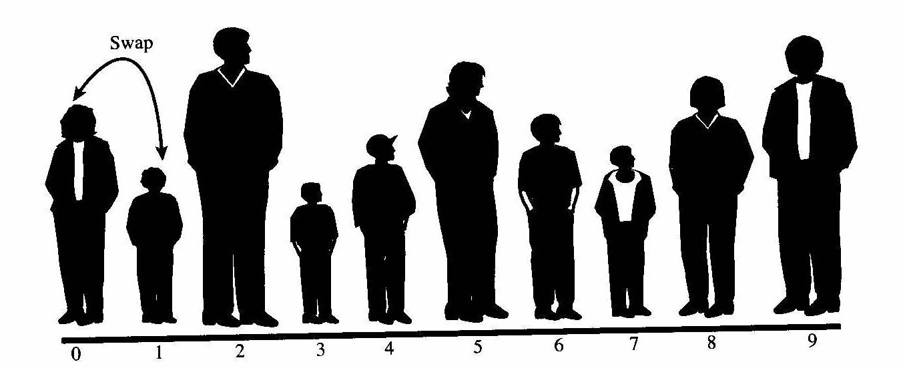
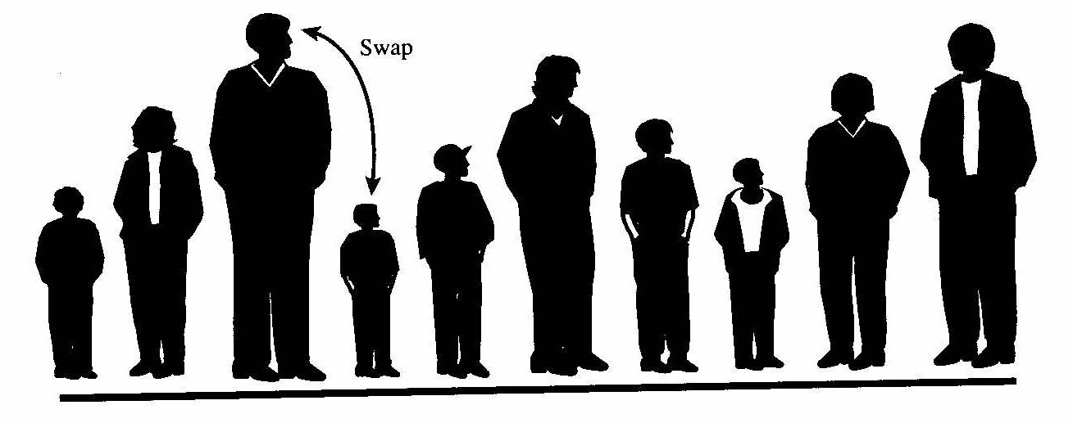
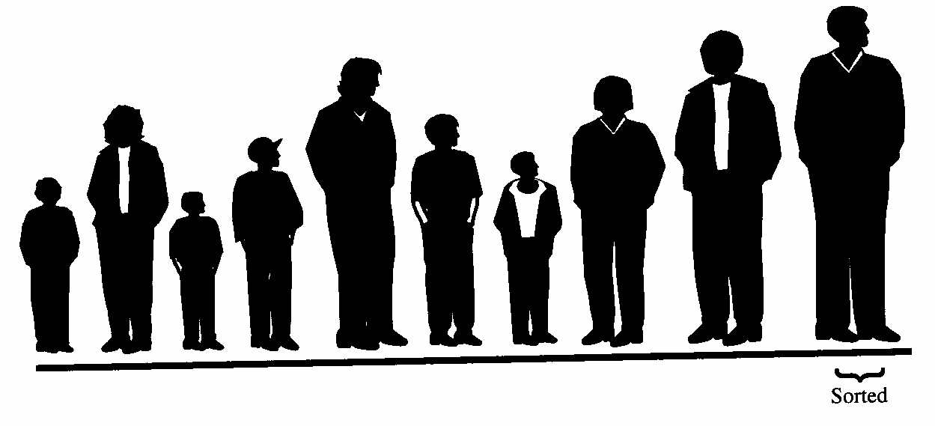
Bubble Sort
Eventually
Faculty of Computer Science, University of Computer Studies(UCSY)

Slide 7
Bubble Sort
Simple but slow
Compare two items
If one on the left is greater, swap them else move right.
Move one position right.
Continue until the end.
The rightmost item is the greatest.
Go back and start another pass from the left end, going towards right, comparing and swapping whenever appropriate.
Stop one item short of the end of the line.
Continue until all items are sorted.
Faculty of Computer Science, University of Computer Studies(UCSY)

Slide 8
Sample Code of Bubble Sort
public void bubbleSort()
{
int out, in;
for(out=nElems-1; out>1; out--) // outer loop (backward)
for(in=0; in<out; in++) // inner loop (forward)
if( a[in] > a[in+1] ) // out of order?
swap(in, in+1); // swap them
} // end bubbleSort
Faculty of Computer Science, University of Computer Studies(UCSY)

Slide 9
Bubble Sort: Analysis
The biggest items “bubble up” to the end of the array, as the algorithm progresses.
Efficiency:
-- if N is number of items,
-- N-1 comparisons in first pass, N-2 in second pass, so on and so forth.
-- The formula is :
(N-1) + (N-2) +…+ 1 = N* (N-1)/2 hence runs in O(N2) time.
Faculty of Computer Science, University of Computer Studies(UCSY)

Slide 10
Applications of Bubble Sort
Bubble sort is a sorting algorithm that is used to sort the elements in an ascending order.
It uses less storage space.
Bubble sort can be beneficial to sort the unsorted elements in a specific order.
It can be used to sort the students on basis of their height in a line.
To create a stack , pile up the elements on basis of their weight.
Faculty of Computer Science, University of Computer Studies(UCSY)

Slide 11
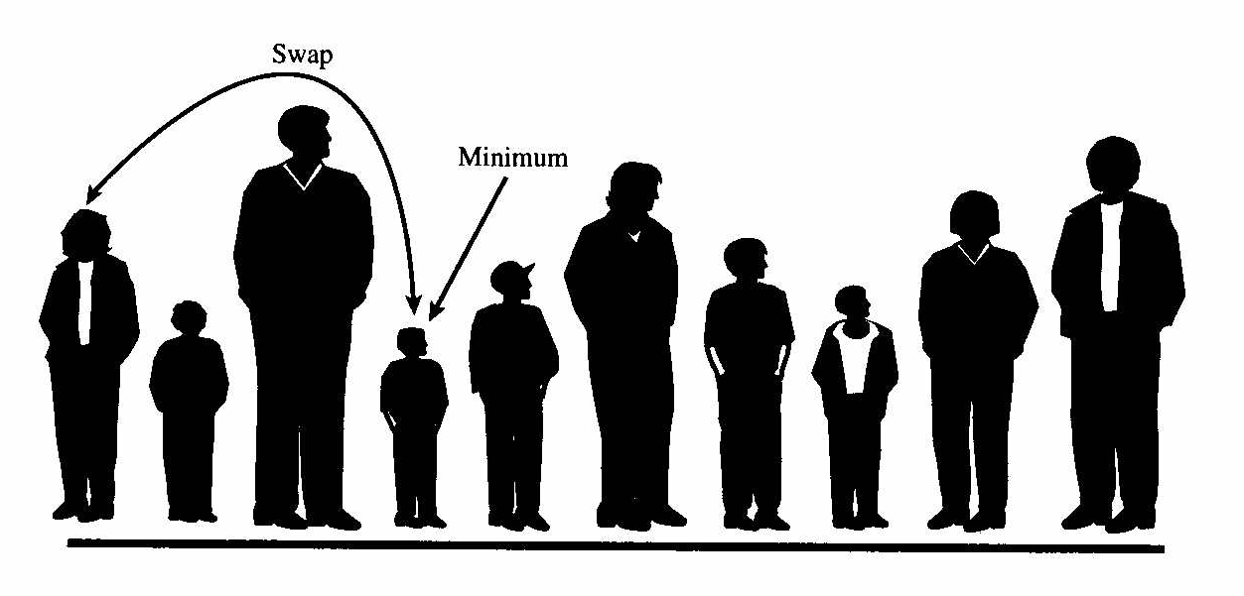
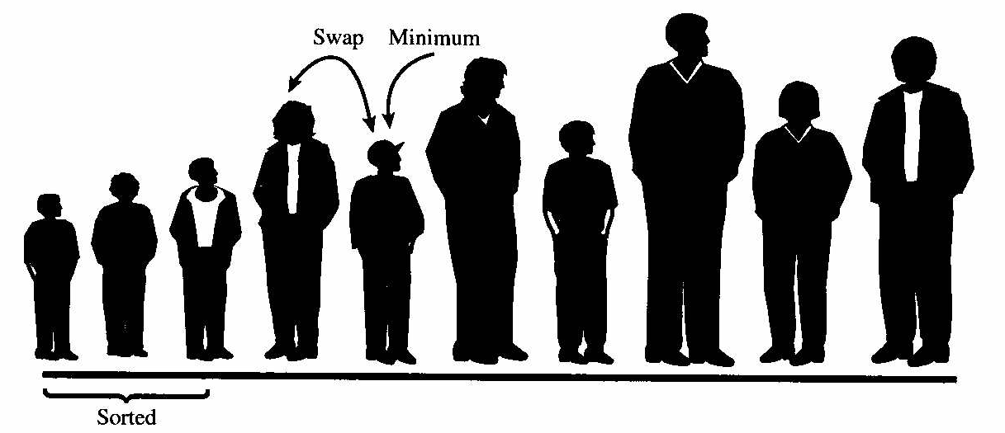
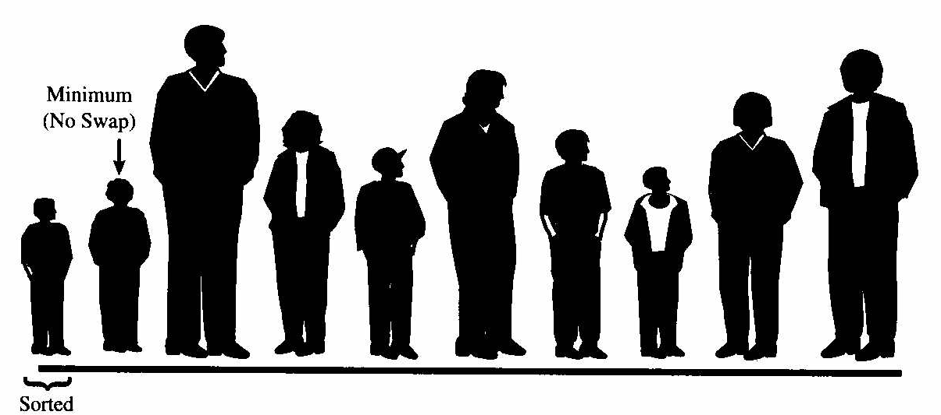
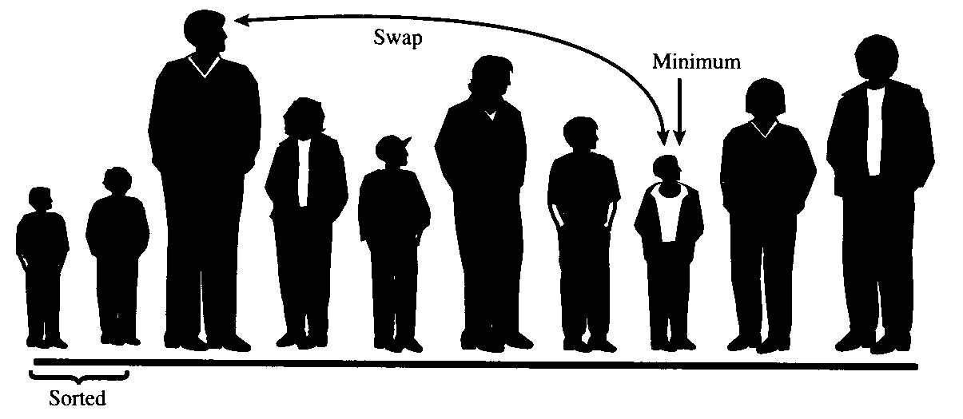
Selection Sort
min
out
1
=
out
3
Faculty of Computer Science, University of Computer Studies(UCSY)

Slide 12
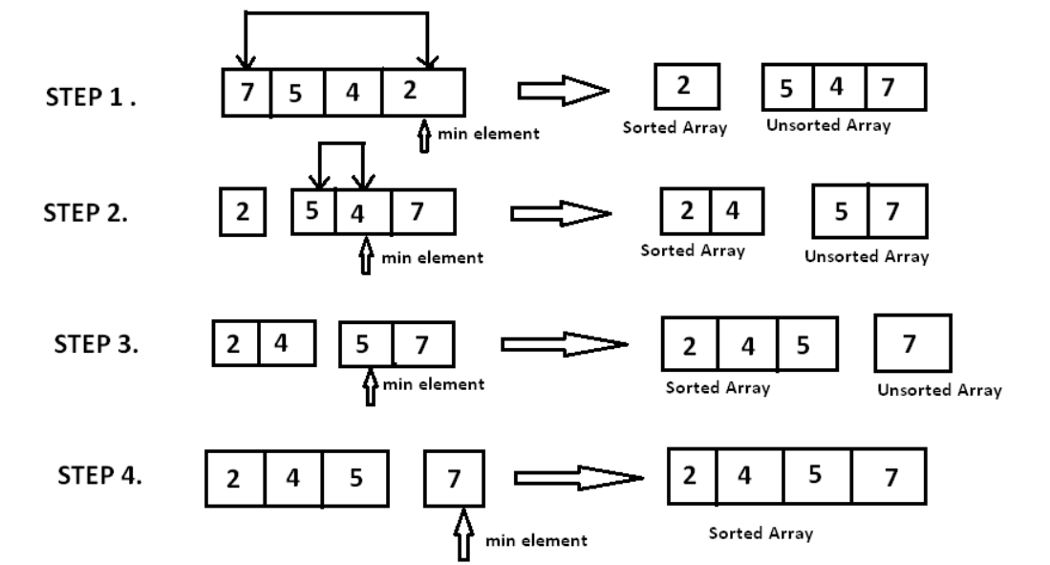
Selection Sort
Faculty of Computer Science, University of Computer Studies(UCSY)

Slide 13
Selection sort Code
public void selectionSort()
{ int out, in, min;
for(out=0; out<nElems-1; out++) // outer loop
{ min = out; // minimum
for(in=out+1; in<nElems; in++) // inner loop
if(a[in] < a[min] ) // if min greater,
min = in; // we have a new min
swap(out, min); // swap them
} // end for(out)
} // end selectionSort()
Faculty of Computer Science, University of Computer Studies(UCSY)

Slide 14
Selection Sort
Reduces number of swaps to O(N).
Start at the left end.
Mark the leftmost item, say as min.
Compare this item with the next item, the shortest among two now becomes min.
Keep comparing till the end, the final min item is swapped at placed at position 0.
Then start with position 1 and repeat the process.
The number of comparisons are more but the number of swaps is considerably reduced.
What situation is this sort good for?
Faculty of Computer Science, University of Computer Studies(UCSY)

Slide 15
Selection Sort
Efficiency:
-- Number of comparisons is same, N*(N-1)/2.
-- runs in O(N2) time.
How do you compare it to Bubble sort?
Faster than bubble sort because of fewer swaps.
Faculty of Computer Science, University of Computer Studies(UCSY)

Slide 16
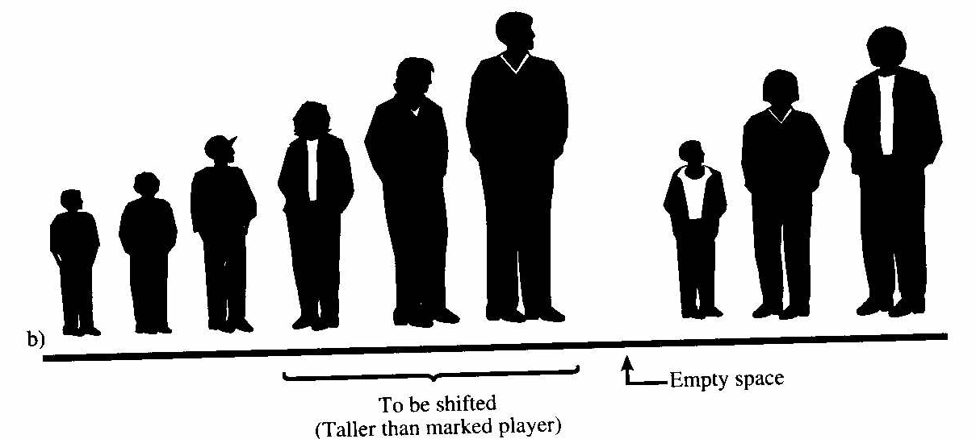
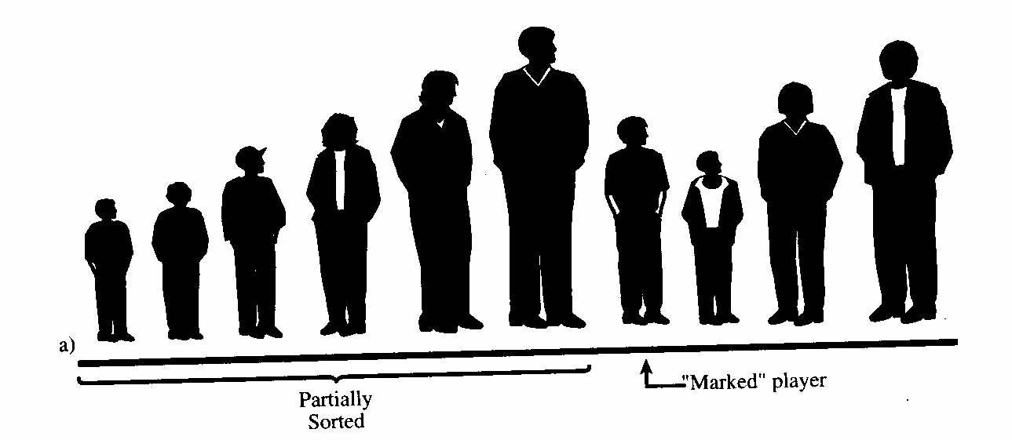
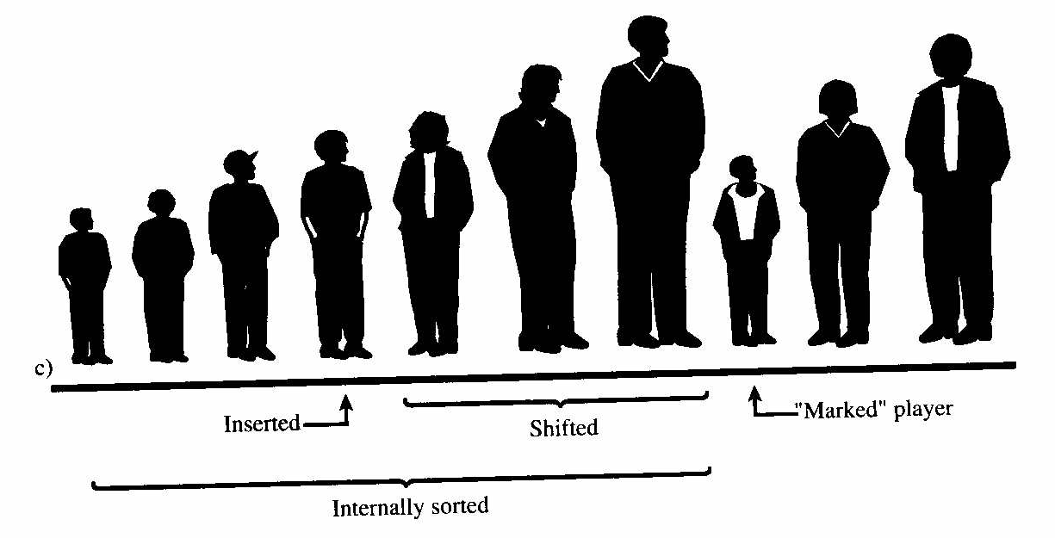
Insertion Sort
Marked
player
Faculty of Computer Science, University of Computer Studies(UCSY)

Slide 17
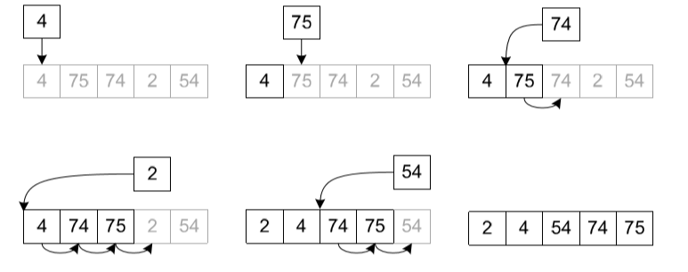
Insertion Sort
Insertion sort is a somewhat interesting algorithm with an expensive runtime of O(n2).
It can be best thought of as a sorting scheme similar to that of sorting a hand of playing cards.
Faculty of Computer Science, University of Computer Studies(UCSY)

Slide 18
Insertion Sort
Assume that the array is half sorted.
The item on the right of the sorted array is “marked”.
Compare this item with each of the items in the sorted array (on the right of marked item)
shifting the elements in the sorted array one position to the right if the “marked” item is smaller.
This process is repeated till the appropriate position of the item is found.
This continues till all the unsorted items are inserted.
Faculty of Computer Science, University of Computer Studies(UCSY)

Slide 19

Insertion sort code
public void insertionSort()
{ int in, out;
for(out=1; out<nElems; out++) // out is dividing line
{
long temp = a[out]; // remove marked item
in = out; // start shifts at out
while(in>0 && a[in-1] >= temp) // until one is smaller,
{ a[in] = a[in-1]; // shift item right,
--in; // go left one position
}
a[in] = temp; // insert marked item
} // end for
} // end insertionSort()
Faculty of Computer Science, University of Computer Studies(UCSY)

Slide 20
Insertion Sort Analysis
On the first pass, compares at the most one item, two on second pass and so on.
N-1 comparisons in the last pass.
On each pass an average of only half of the maximum number of items are actually compared before the insertion point is found.
N*(N-1)/4 comparisons.
Since there is no swapping, it is twice as faster than bubble sort and faster than selection Sort.
Runs in O(N2) time.
Faculty of Computer Science, University of Computer Studies(UCSY)

Slide 21
Insertion Sort
For already sorted data, runs in O(N) time.
For data arranged in inverse order, runs no faster than bubble sort.
Faculty of Computer Science, University of Computer Studies(UCSY)

Slide 22
Comparison
Bubble sort is useful for small amounts of data.
Selection sort can be used when amount of data is small and swapping is time-consuming.
Insertion sort is most versatile and the best when the list is almost sorted.
Faculty of Computer Science, University of Computer Studies(UCSY)

Slide 23
Summary
The sorting algorithms in this chapter all assume an array as a data storage structure.
Sorting involves comparing the keys of data items in the array and moving the items around until they’re in sorted order.
All the algorithms in this chapter execute in O(N2) time.
The bubble sort is the least efficient, but the simplest, sort.
The insertion sort is the most commonly used of the O(N2) sorts described in this chapter.
Faculty of Computer Science, University of Computer Studies(UCSY)

Slide 24
Reference
Data Structures and Algorithms in Java, Second Edition
Copyright © 2003 by Sams Publishing
Faculty of Computer Science, University of Computer Studies(UCSY)

Slide 25
Thank You
Faculty of Computer Science, University of Computer Studies(UCSY)

